Slide 1
Predicting a European Top 5 League Soccer Team’s Point Total Using Multiple Linear Regression
By Kosta Marcopulos

Slide 2
Objective
The objective of our project is to predict a season point total for teams in the top 5 European soccer leagues.
Will use 6 years of team data that includes points, total shots, shot % on target, and total touches in the penalty area.

Slide 3
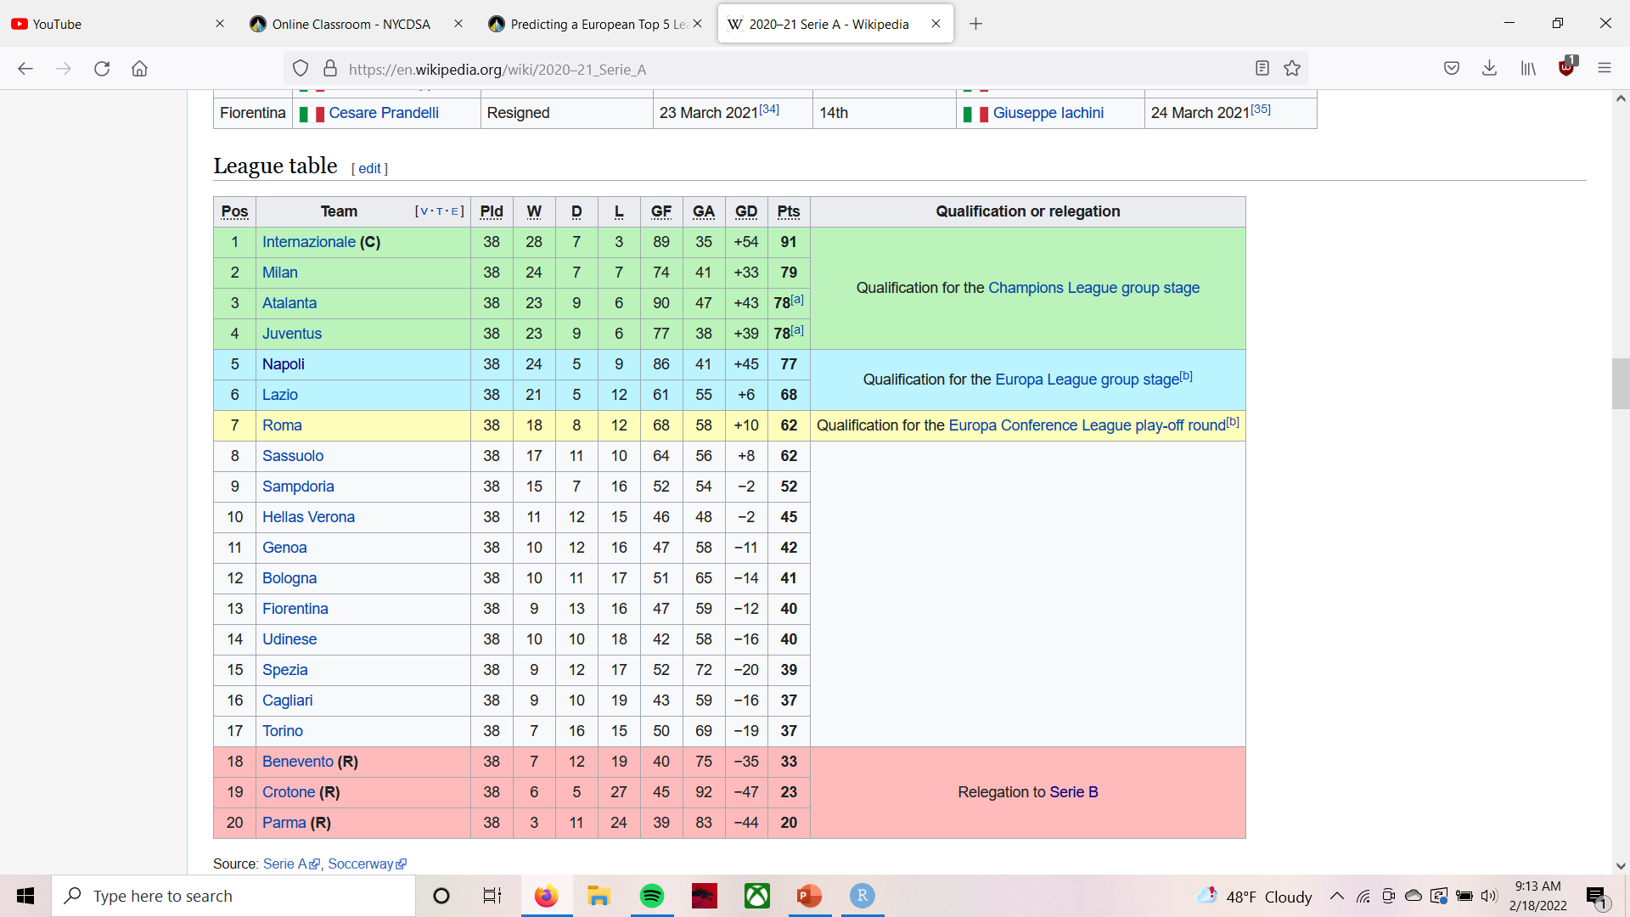
Why Is This Important?
Potential to make over $100 million from UCL.
Prize pool of 500 million Euros across Europa League.
Europa Conference League is a new competition with much smaller prize pool.
Prize distribution based on performance, TV rights, and club coefficient.

Slide 4
Overview of Data
All data used is sourced from Wyscout.
Data references team league data from 2015/16 season through 2020/21 season for top 5 European leagues.
The 2019/20 Ligue 1 season was omitted as it was permanently stopped due to COVID.
Data contains 568 observations and 7 variables.
3 character features – Team, League, Year
4 numeric features – Points, Total Shots, Shot % on Target, Total Touches in Penalty Area.

Slide 5
Data Split
Random split of data into train and test sets. Split was 75%/25%.
Team Data
Train Data – 75%
Test Data – 25%

Slide 6
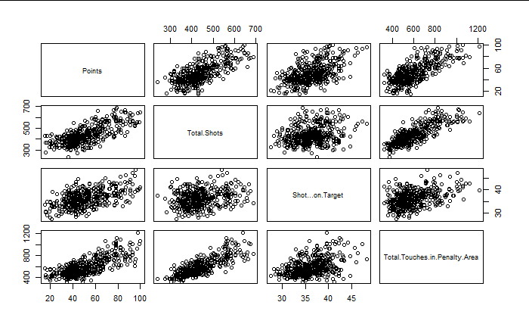
Pairs
Correlation Between Points and Three Features | Points
Total Shots | 0.7261143
Shot % on Target | 0.5392946
Total Touches in Penalty Area | 0.7455045

Slide 7
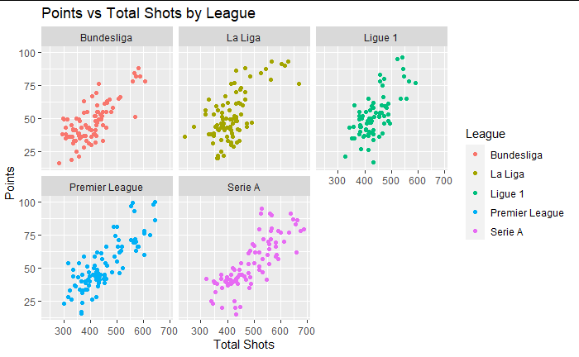
EDA by League

Slide 8
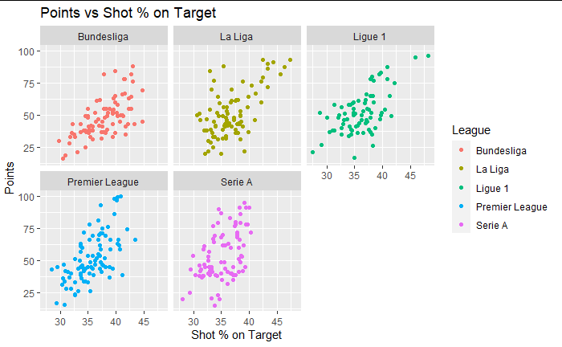
EDA by League

Slide 9
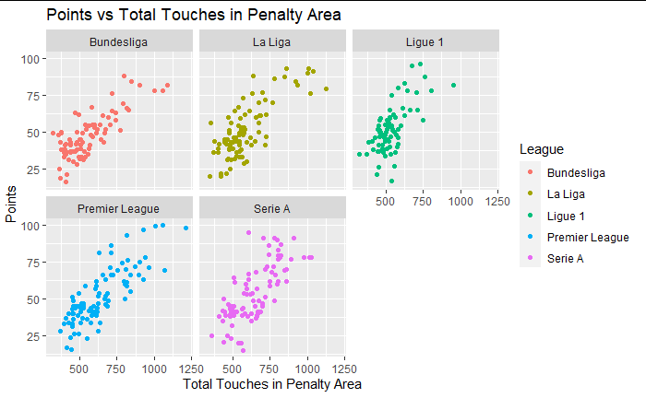
EDA by League

Slide 10
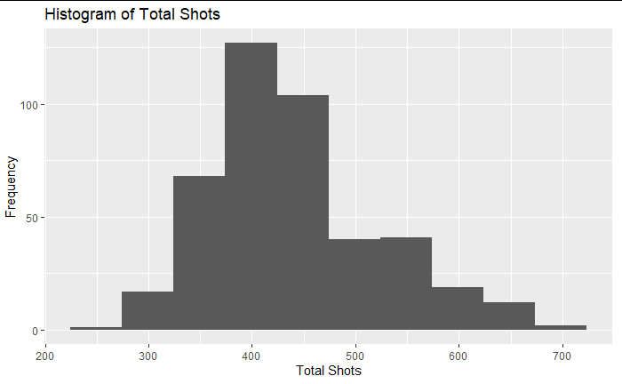
Distribution – Total Shots

Slide 11
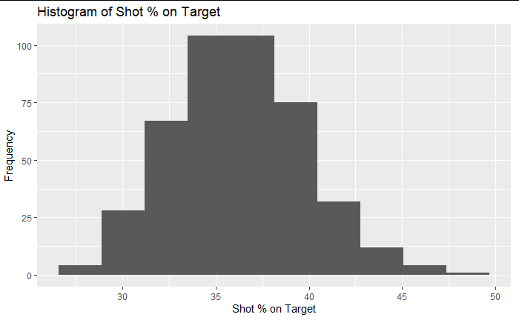
Distribution – Shot % on Target

Slide 12
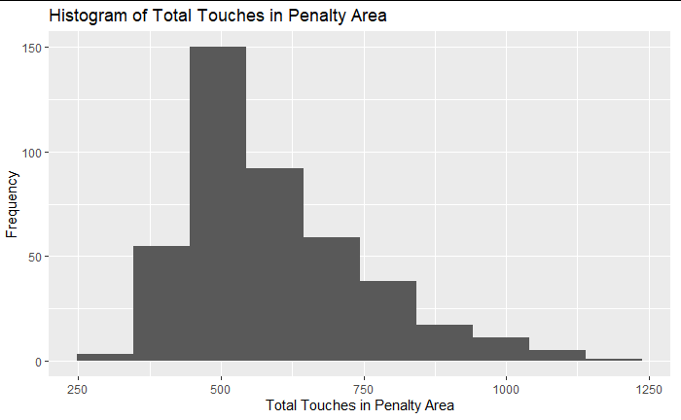
Distribution – Total Touches in Penalty Area

Slide 13
Models Evaluated
Mod_1
BC_Mod_1
Mod_2
BC_Mod_2
Points ~ Total Shots + Shot % on Target + Total Touches in Penalty Area
(Points^lambda1-1)/lambda1) ~ Total Shots + Shot % on Target + Total Touches in Penalty Area
Points ~ Total Shots + Shot % on Target
(Points^lambda2-1)/lambda2) ~ Total Shots + Shot % on Target

Slide 14
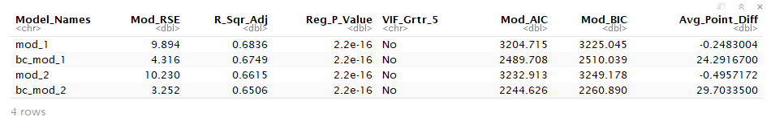
Summary of Models

Slide 15
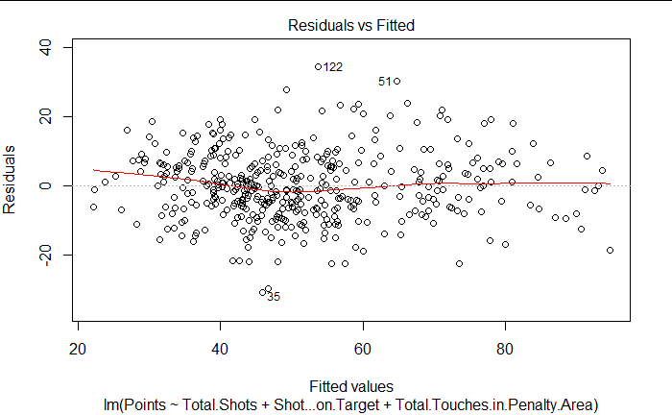
Mod_1 – Deeper Dive
Data is not heteroscedastic.
Data does not display a nonlinear pattern.
A few potential outliers (122, 51, 35). We will evaluate these later.

Slide 16
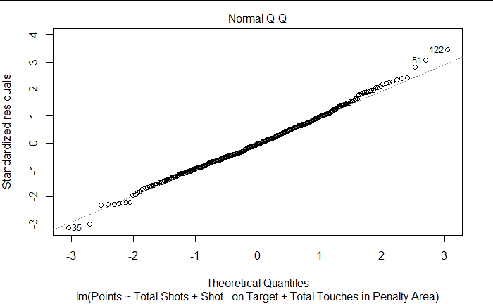
Mod_1 – Deeper Dive
Slight deviation at the ends of our Q-Q plot.
Points follow straight line for the most part.
Extremes are statistically significant, as there are typically few times performing at an elite level and few teams at a relegation level.

Slide 17
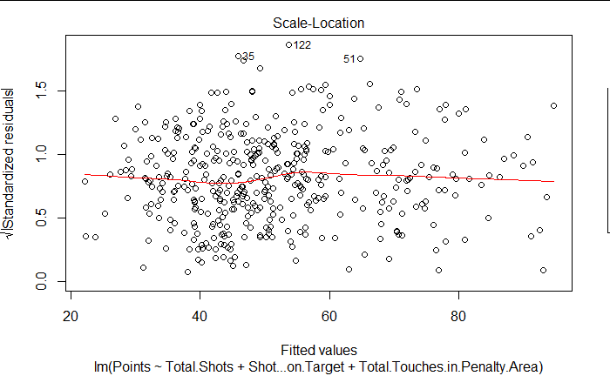
Mod_1 – Deeper Dive
Scale-Location shows a fairly random spread of our data points.
This shows that we should not have an issue with variance.

Slide 18
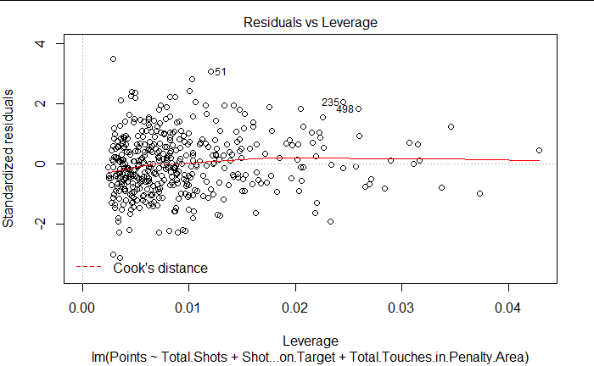
Mod_1 – Deeper Dive
Residuals vs Leverage plot shows that any potential outliers are not influential against our regression line.
No point breaches Cook’s distance line.

Slide 19
Conclusion
Mod_1 would be the most effective when predicting a season point total based on our selected features.
Deployment
Preseason to evaluate your teams point prediction relative to the other teams in the league. This can be done by computing the total expected shots of each player, expected shots on target, and expected touches in the penalty area.
A-B Testing. Evaluate the increase/decrease in projected points by swapping a player into the lineup. Particularly useful when evaluating potential transfers.
Future Plans
Add more features to the model. This includes additional offensive metrics and defensive metrics.
Compare the accuracy of the current model to the future model that will be made.

